Slide 1
DIABETIC PREDICTION USING LOGISTIC REGRESSION

Slide 2
BACKGROUND
Diabetes mellitus (DM), commonly known as diabetes, is a group of metabolic disorders characterized by a high blood sugar level over a prolonged period of time
Symptoms often include frequent urination, increased thirst, and increased appetite
If left untreated, diabetes can cause many complications. Acute complications can include diabetic ketoacidosis, hyperosmolar hyperglycemic state, or death
Serious long-term complications include cardiovascular disease, stroke, chronic kidney disease, foot ulcers, damage to the nerves, damage to the eyes and cognitive impairment
As of 2019, an estimated 463 million people had diabetes worldwide (8.8% of the adult population). Rates are similar in women and men. Trends suggest that rates will continue to rise
Diabetes at least doubles a person's risk of early death. In 2019, diabetes resulted in approximately 4.2 million deaths. It is the 7th leading cause of death globally.

Slide 3
PROBLEM STATEMENT
The dataset providing details of certain numbers of persons under scrutiny with different medical conditions might be helpful to prepare an algorithm which may be helpful to predict whether a person under consideration may have diabetes or not

Slide 4
INTEREST
It would be naturally of interest to medical researcher or practioners. At the same point of time it would be beneficial for an individual being to ascertain whether he/she is in high risk zone or not when it comes to being diagnosed with diabetes

Slide 5
DATA SOURCE
The data being used for this study was made available by “National Institute of Diabetes and Digestive and Kidney Diseases” as part of the Pima Indians Diabetes Database
Several constraints were placed on the selection of these instances from a larger database
In particular, all patients here belong to the Pima Indian heritage (subgroup of Native Americans), and are females of ages 21 and above
This dataset was available in Kaggle dataset as an open dataset for study
The dataset has a total of 8 features to determine the final outcome i.e. whether the concerned person is diabetic or not
For this purpose a total of 768 samples being considered

Slide 6
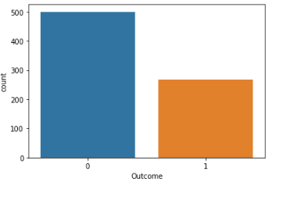
EXPLORATORY ANALYSIS
The test shows that out of 768 samples 500 samples are negative i.e. non-diabetic whereas 268 samples are positive i.e. diabetic

Slide 7
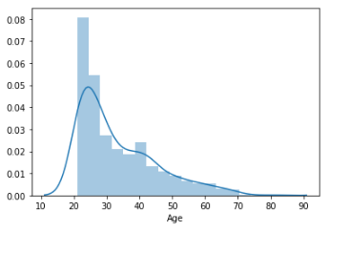
EXPLORATORY ANALYSIS contd.
The following figure depicts the relationship between the outcome with different age group

Slide 8
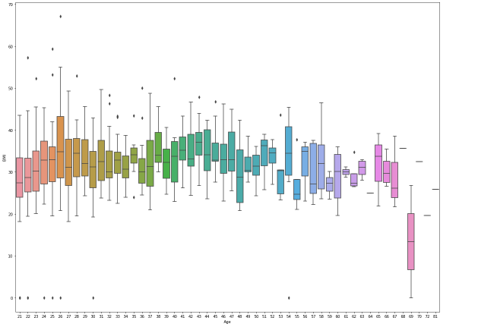
EXPLORATORY ANALYSIS contd.
A box plot analysis of the outcome at different age

Slide 9
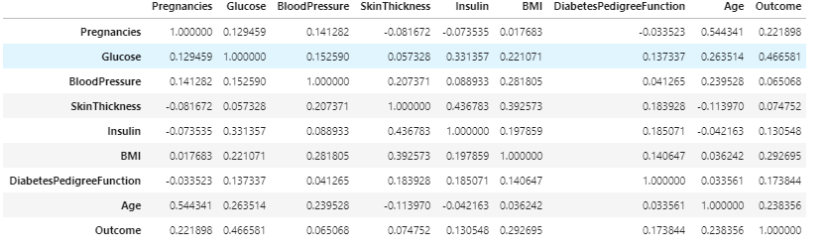
CORRELATION
The following table shows the correlation between different features

Slide 10
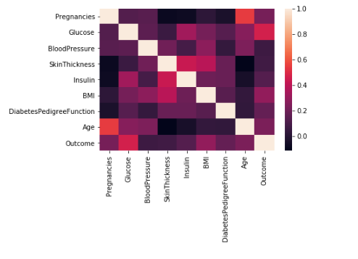
CORRELATION HEATMAP
Heatmap visual will emphasize the correlation data

Slide 11
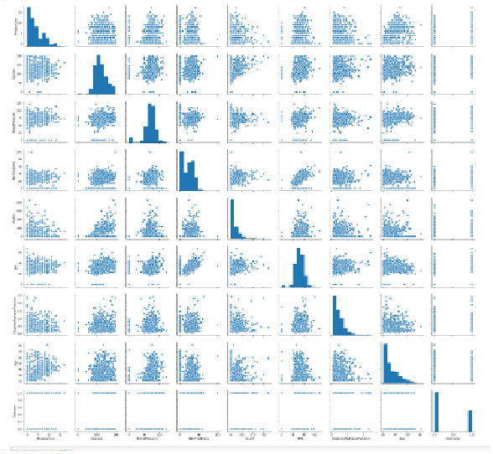
PAIRPLOT DATA

Slide 12
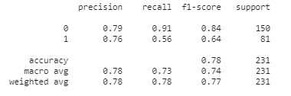
PREDICTIVE MODELLING
For the purpose of predictive modelling logistic regression is being used
The dataset has been split in training set and test set in the ration of 7:3
The classification report of the model is as follows which signifies an accuracy of 72-80%

Slide 13
CONCLUSION
The dataset being used though of a certain ethnicity the procedural development of the model may be used for a dataset which reduces this bias
The medical conditions being considered for this study is limited to a few nos only and there may be other different reasons which may help to determine the outcome more accurately and thus may increase the accuracy of the model.

Slide 14
THANK YOU

